Slide 1
NSA Codebreaker 2017
Armer

Slide 2
Task 1 - Analyze Suspicious Traffic
Requirements
Analyze pcap containing MQTT traffic
ID 9 malicious IPs
Tools used
Wireshark

Slide 3
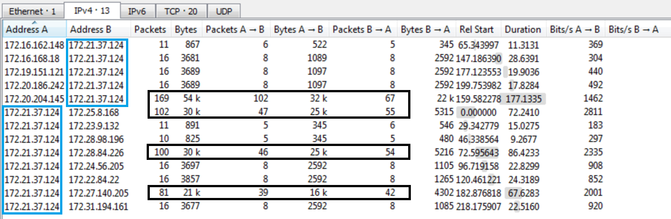
Task 1 - Conversations
List of IPs who are talking with each other
Notes:
Looking at the number of packets sent in each conversation you can see that 4 of them sent 39+ packets. The other 9 IPs sent 5-8 packets, which seems odd

Slide 4
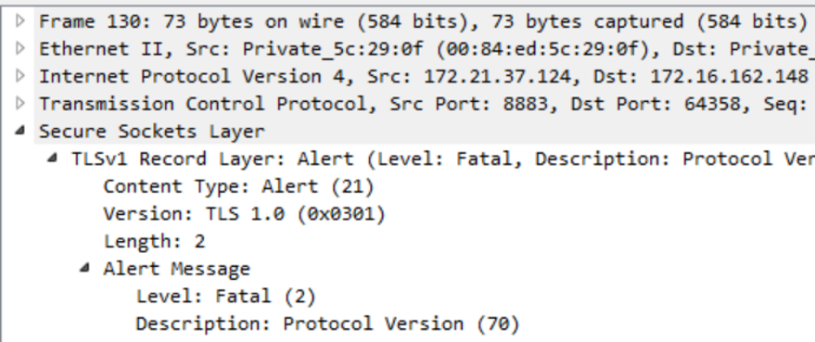
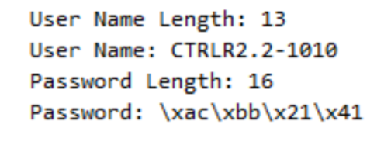
Task 1 – Deeper Look
172.16.168.18
172.16.162.148

Slide 5
Task 2 - Analyze Suspicious Traffic
Requirements
Analyze pcap containing encrypted MQTT traffic
ID Unk number of malicious IPs
Write Bro/Snort rules to automate alerts
Tools used
Wireshark
Snort

Slide 6
Task 2 – Connection Errors
Wrong Protocol Version
ssl.alert_message.desc == 70
Handshake Failure
ssl.alert_message.desc == 40
Notes:
Looking at the number of packets sent in each conversation you can see that 4 of them sent 39+ packets. The other 9 IPs sent 5-8 packets, which seems odd

Slide 7
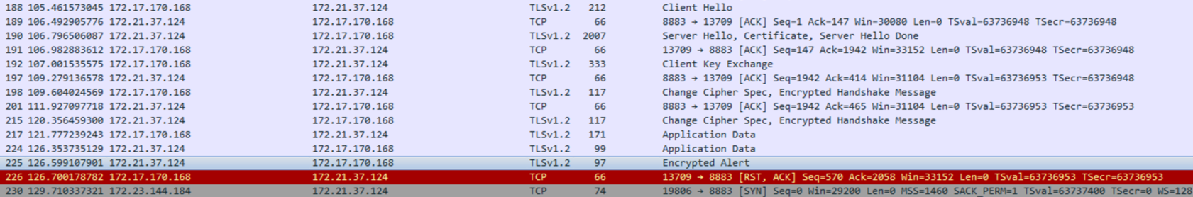
Task 2 – Connection Errors
Encrypted Alert
X
TCP flags FIN, PSH and ACK set
Notes:
Looking at the number of packets sent in each conversation you can see that 4 of them sent 39+ packets. The other 9 IPs sent 5-8 packets, which seems odd

Slide 8
Task 2 – Snort Rules
Wrong Protocol Version
alert tcp 172.21.37.124 8883 -> any any (msg:"poss malicious - Wrong protocol"; dsize: 7; content:"|46|"; rawbytes; offset: 6; depth: 1; sid: 1000000;)
Handshake Failure
alert tcp 172.21.37.124 8883 -> any any (msg:"poss malicious - Handshake failure"; dsize: 7; content:"|28|"; rawbytes; offset: 6; depth: 1; sid: 1000001;)
Encrypted Alert
alert tcp 172.21.37.124 8883 -> any any (msg:"poss malicious - Encrypted alert"; flags: FPA; dsize: 31; content:"|15|"; rawbytes; offset: 0; depth: 1; sid: 1000002;)

Slide 9
Task 2 – Snort Rule
Encrypted Alert breakout
Server IP and port
Any client and port
alert tcp 172.21.37.124 8883 -> any any (msg:"poss malicious - Encrypted alert"; flags: FPA; dsize: 31; content:"|15|"; rawbytes; offset: 0; depth: 1; sid: 1000002;)
Data size
Check for 0x15
Check only 1 byte
Start check at offset 0
Check for flags FIN, PSH, ACK
Check raw bytes
Notes:
Looking at the number of packets sent in each conversation you can see that 4 of them sent 39+ packets. The other 9 IPs sent 5-8 packets, which seems odd

Slide 10
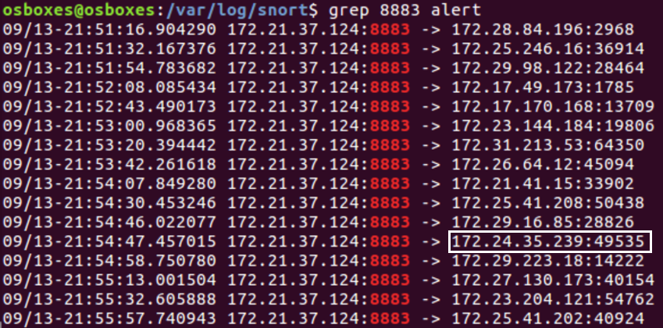
Task 2 – Snort Results
Search through snort alerts using grep
One false positive

Slide 11
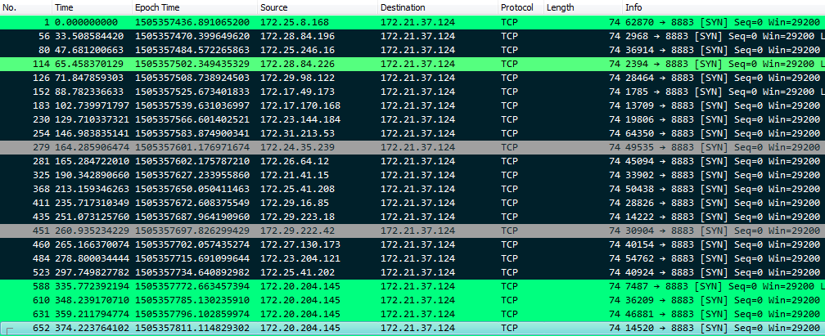
Task 2 – Malicious Traffic
Malicious Traffic highlighted black

Slide 12
Task 3 - Analyze C Source Code
Requirements
Analyze authentication scheme
Write exploit if vulnerability found
Tools used
Wireshark
Python

Slide 13
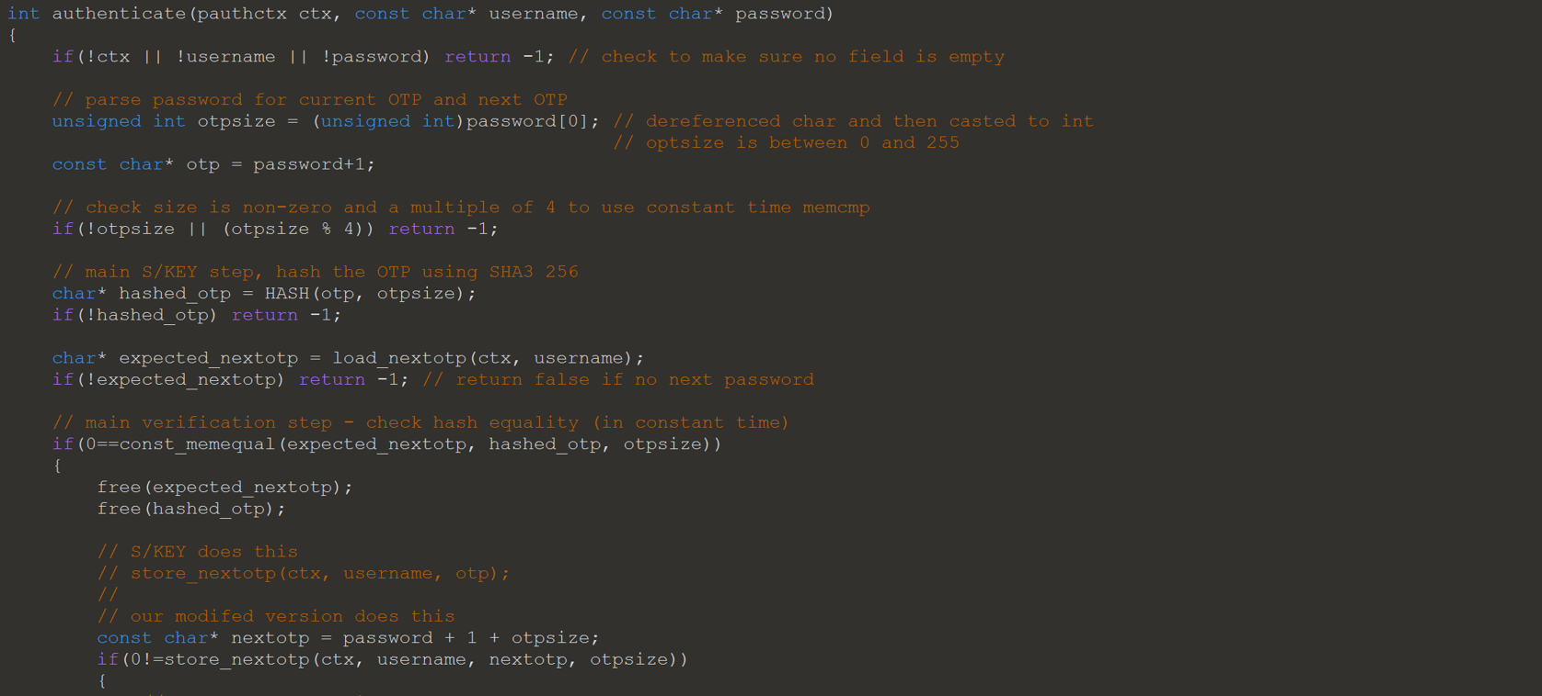
Task 3 - Analyze C Source Code

Slide 14
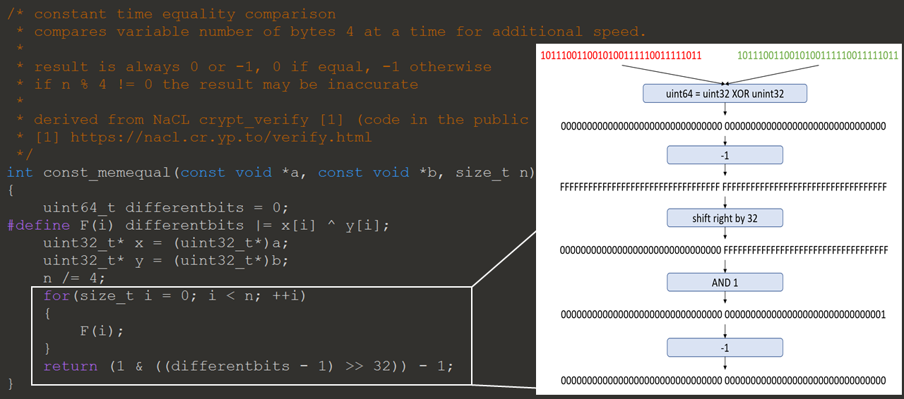
Task 3 - Analyze C Source Code

Slide 15
Task 3 - Analyze C Source Code
Vulnerability
Partial Hash Collision
Reason
Can tell authenticator size of password
Size is used in hash and compare function

Slide 16
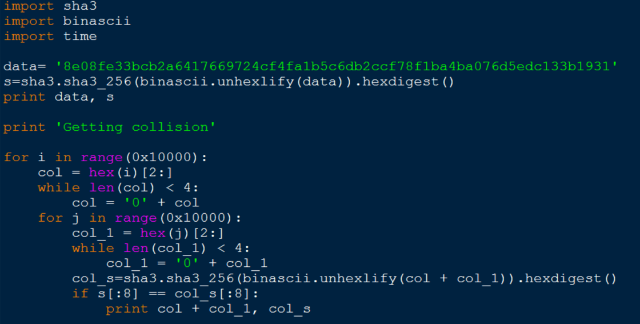
Task 3 - Analyze C Source Code
Retrieved first password using Wireshark
Wrote Python script to find collision

Slide 17
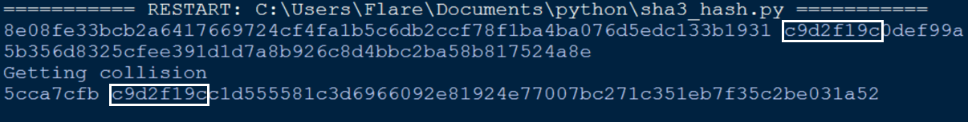
Task 3 - Result
Password format needed to exploit
<opt size><password><next password>
0x045cca7cfb5cca7cfb

Slide 18
Task 4 - Analyze Linux Library
Requirements
Analyze function used to authenticate critical messages
Vulnerability to authenticate arbitrary messages
No source code
Tools used
IDA Pro
Wireshark
Python

Slide 19
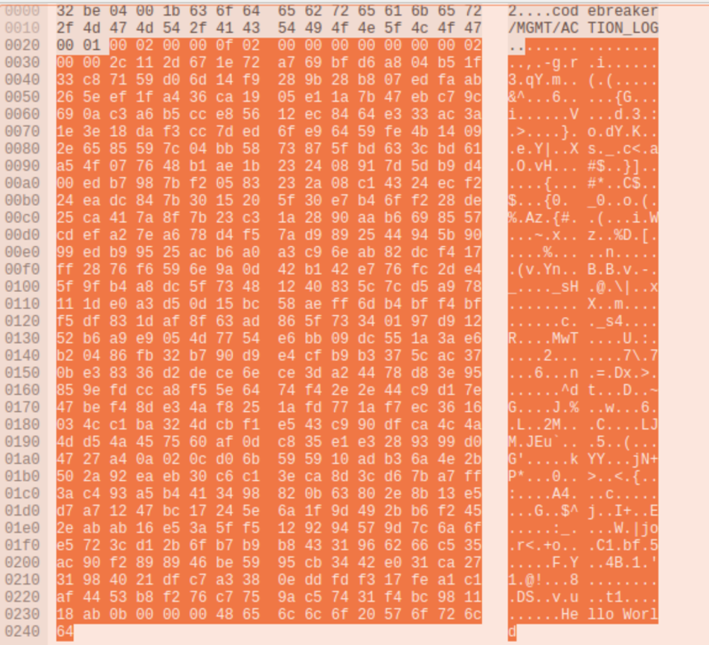
Task 4 - Legitimate Message
Wireshark capture
MQTT message to log Hello World
Message Contents
MQTT topic
Header
16 bytes
RSA signature
512 bytes
Message contents

Slide 20
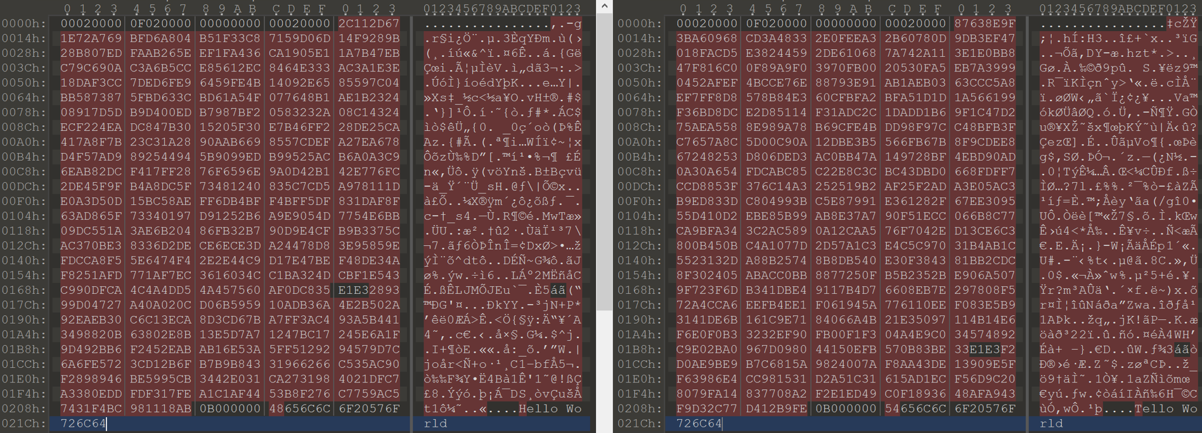
Task 4 - Legitimate Message
Wireshark capture
Same length message

Slide 21
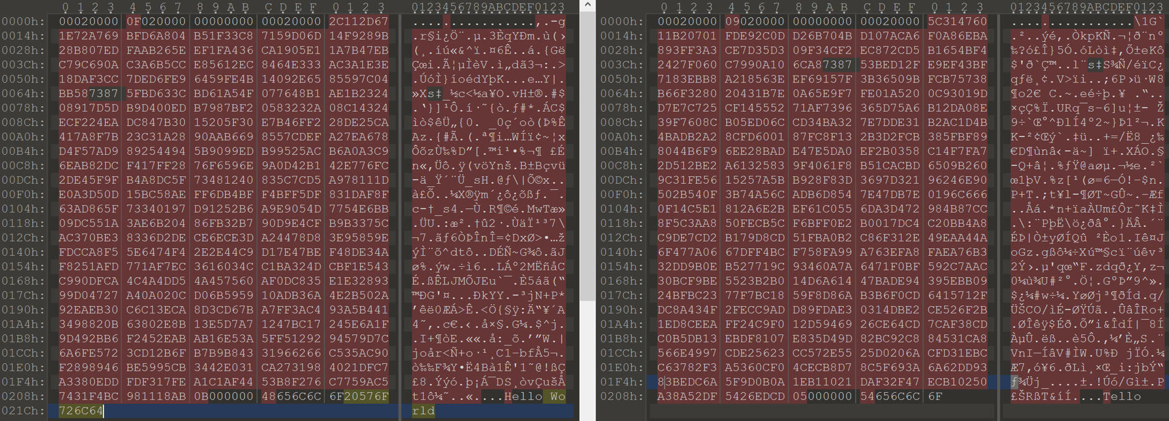
Task 4 - Legitimate Message
Wireshark capture
Different length message

Slide 22
Task 4 – Library Function Flow
Flow of validate_msg_signature
Retrieve RSA key
Hash message content using SHA512
message is determined by [length_of_message] – [length_of_signature]
Verify RSA signature of the hash
Set message pointer to [offset_of_message]

Slide 23
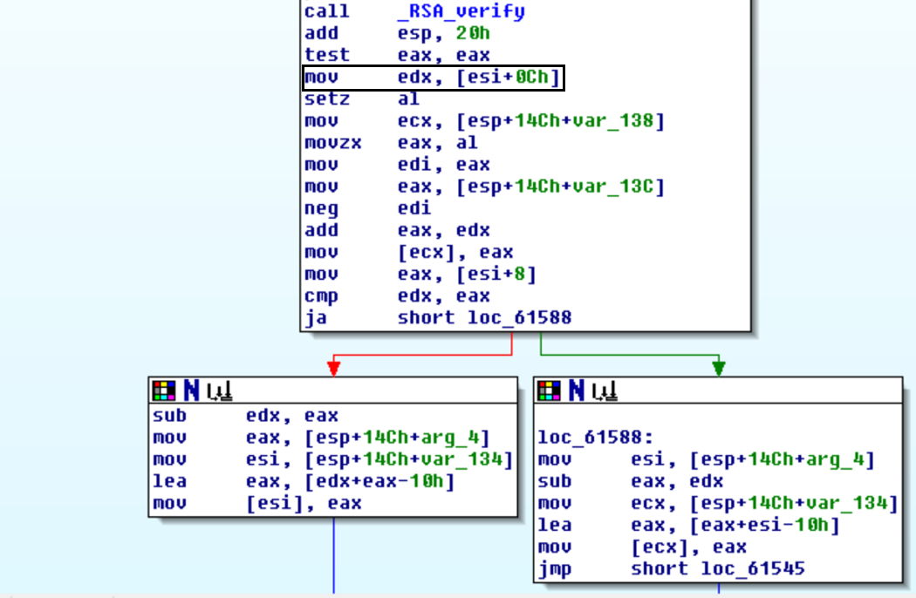
Task 4 - Library Function Flow
Fourth field is key to exploit
Only used after authentication

Slide 24
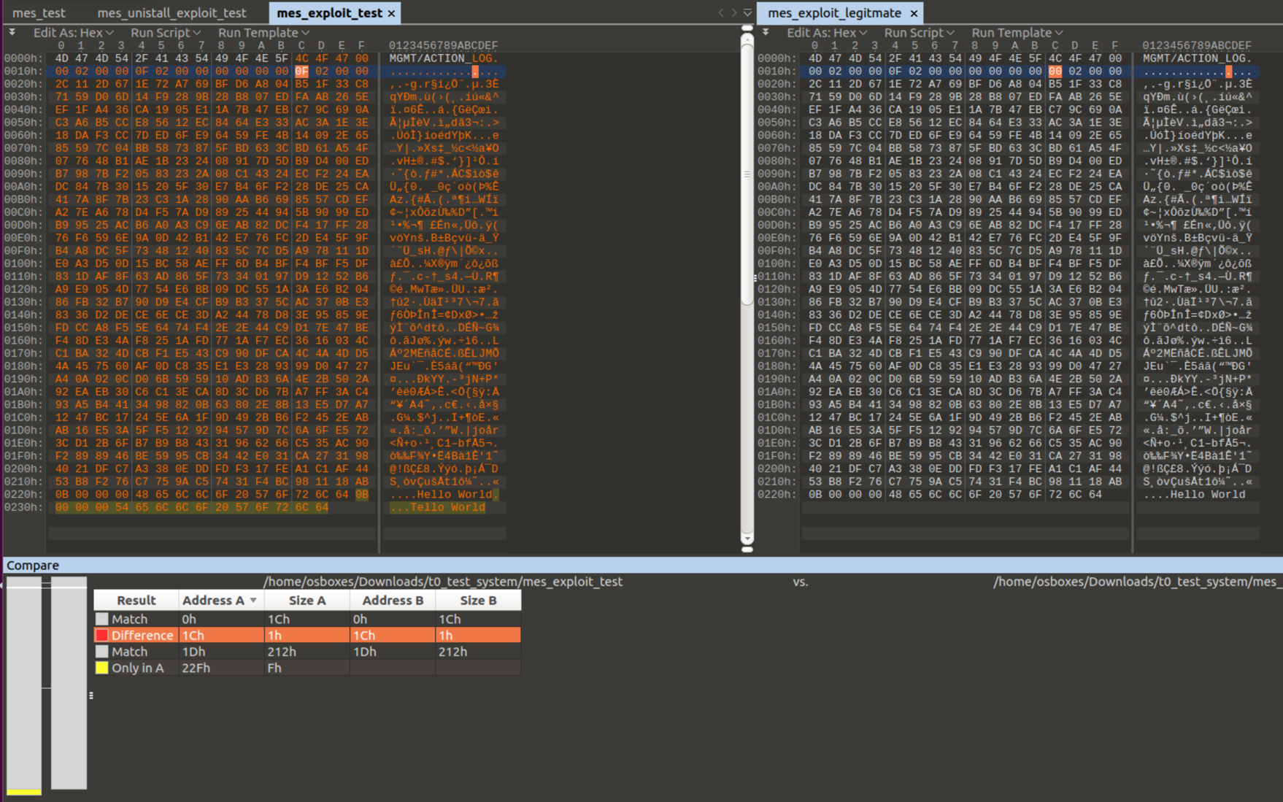
Task 4 – Fake Message
Steps
Attach message at end
Adjust last field of header to point to message

Slide 25
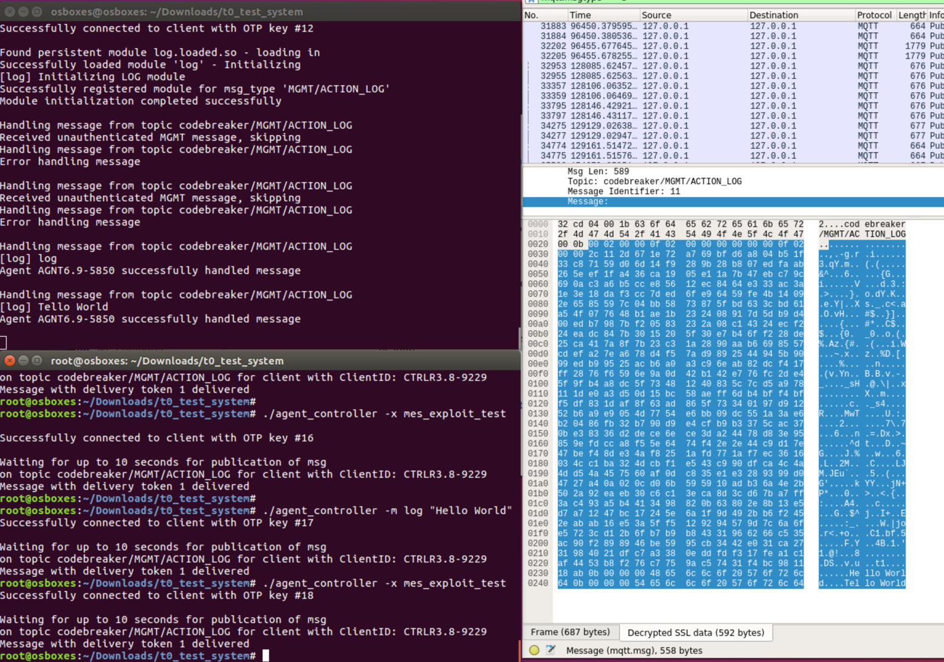
Task 4 – Success
Message signature was for Hello World
Tello World was logged instead

Slide 26
Task 5 – Analyze Linux Memory Capture
Requirements
Analyze Linux memory capture
ID MQTT topic attacker is using
ID PID of malicious process
ID information that can be used to find web server
IP can change, need something else
Tools used
IDA Pro
Volatility
Python

Slide 27
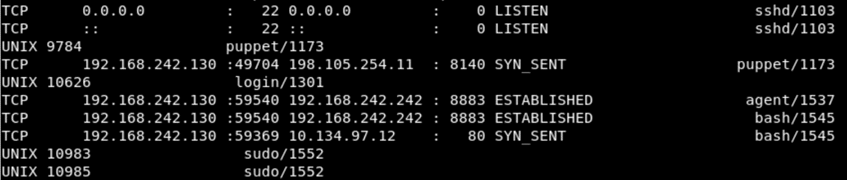
Task 5 – Malicious Process
Ran linux_netstat
Connection to IP 10.134.97.12 on port 80, by PID 1545
This gave me the PID to look into further

Slide 28
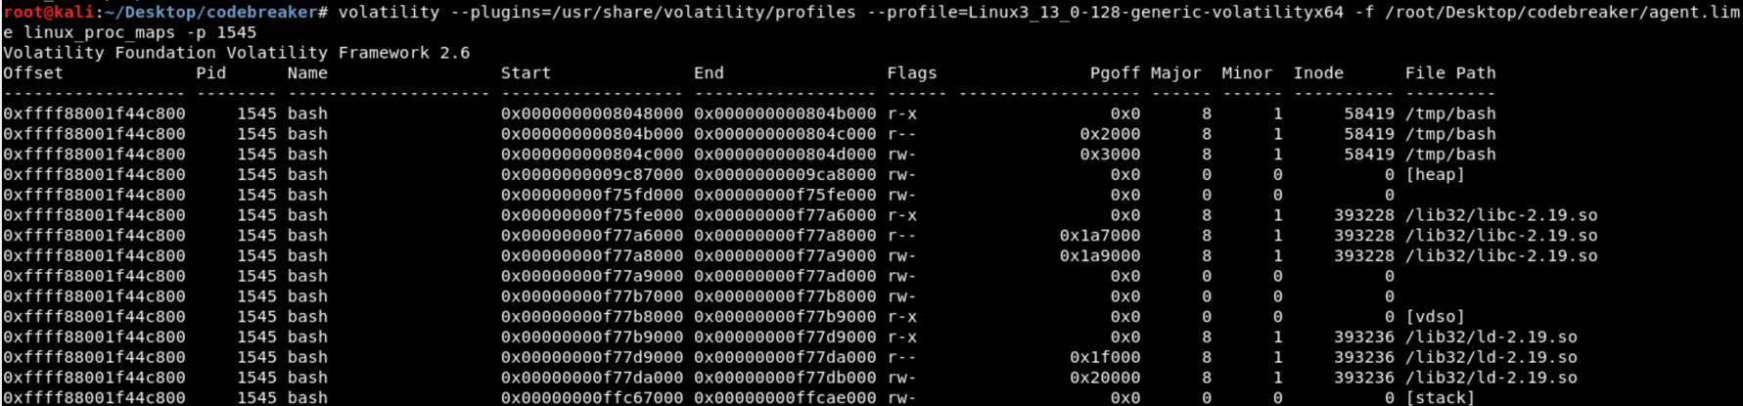
Task 5 – Malicious Process
Ran linux_proc_dump for PID 1545
Memory maps
Lists file path of /tmp/bash

Slide 29
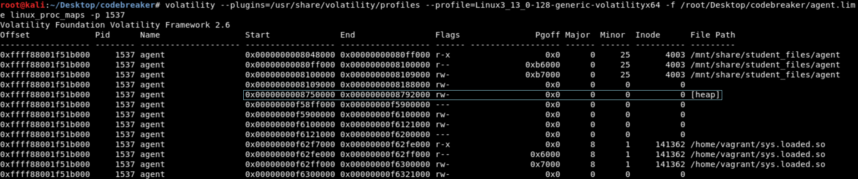
Task 5 – Attacker’s MQTT Topic
Ran linux_proc_dump for PID 1537
Memory maps
Got address of the process’ heap

Slide 30
Task 5 – Attacker’s MQTT Topic
Dumped the heap
Ran strings task.1537.0x8750000.vma | grep MODULE
Found codebreaker/MODULE/sys_16575f98/nodes-15411b7b

Slide 31
Task 5 – Identifying Information
Retrieving Malicious process
linux_procdump
Dump executable from memory
linux_find_file
Dumps file from cached filesystem

Slide 32
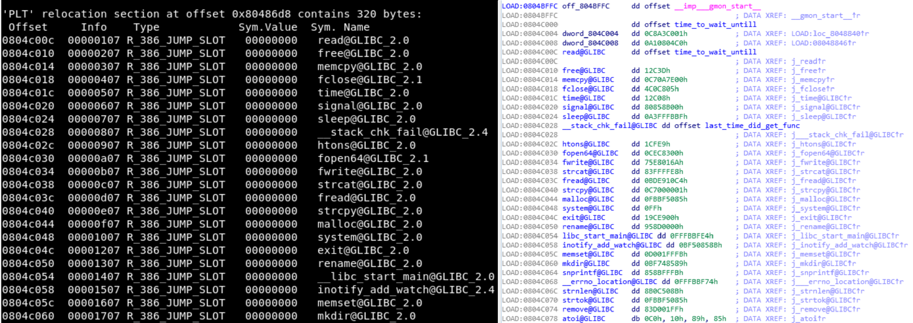
Task 5 – Identifying Information
The Procedure Linkage Table (PLT) needed to be restored
Used readelf -D -r bash

Slide 33
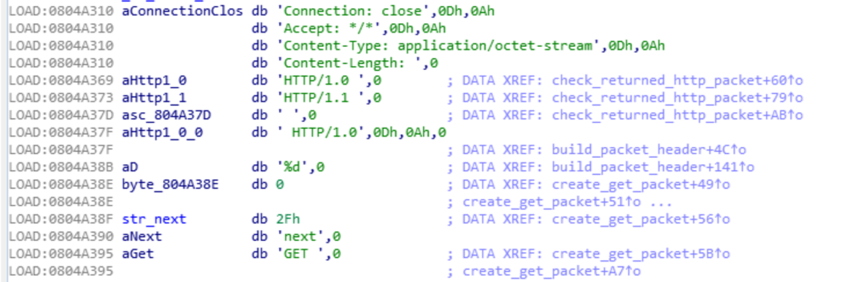
Task 5 – Identifying Information
Used strings in IDA to narrow search
HTTP requests are text based

Slide 34
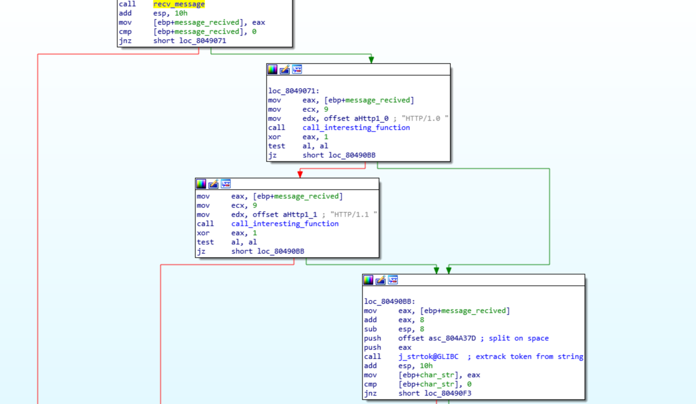
Task 5 – Identifying Information
Followed string references
Took me to the functions to build and check HTTP packets

Slide 35
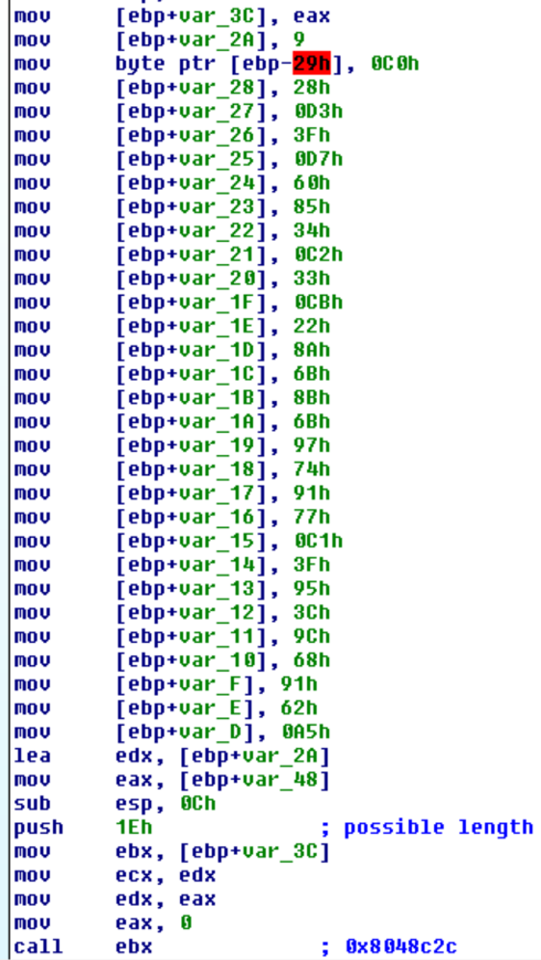
Task 5 – Identifying Information
Check function will check returned HTTP header
Stack string is not text based
Dynamically calling function

Slide 36
Task 5 – Identifying Information
Thought I found the called function
Matched arguments passed in
Matched expected return value
Was used to check that 2 arguments matched
Where I went wrong
Got hung up on this was the right function
Would have been comparing text to non-text
Wasted time looking for other answers

Slide 37
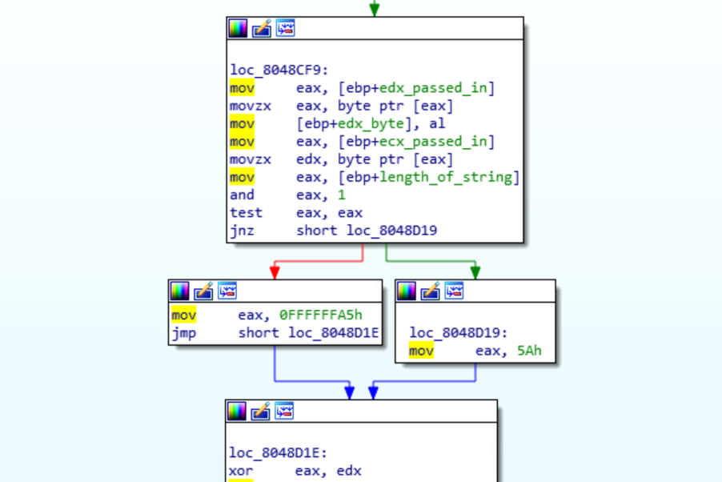
Task 5 – Identifying Information
Real Function being called
Found looking through IDA text view for code
IDA will only populate function list with called functions
Decodes stack string before compare

Slide 38
Task 5 – Identifying Information
Wrote Python script to decrypt stack string
Result was Server: nginx/1.12.4-de0f9248

Slide 39
Task 6 – Exploit Attacker’s C2 Server
Requirements
Analyze Attacker’s C2 Server
ID vulnerabilities
Craft MQTT message to bot that will exploit server
Less than 3 MB
Tools used
IDA Pro
Python
Docker

Slide 40
Task 6 – Getting C2 Server to run
Wasn’t able to complete during competition
Was able to determine
Server was python3.5 based
Used pyrun
Got server to run from reddit hint
To get initial source code can use python to unzip server
Then need to analyze code to get further
Used uncompyle6
Decompiles Python

Slide 41
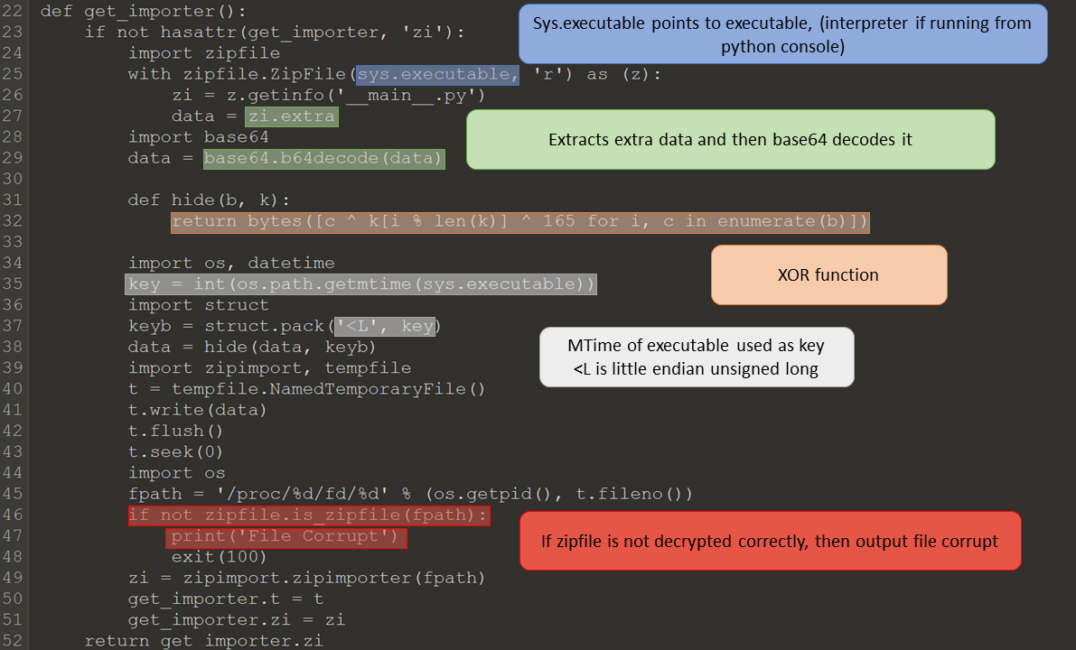
Task 6 – Getting C2 Server to run

Slide 42
Task 6 – Getting C2 Server to run
XOR function
(Plain Text) XOR (Extra Bytes) XOR (MTime) = (Encrypted Text)
To get the MTime, the following can be done:
(Plain Text) XOR (Extra Bytes) XOR (Encrypted Text) = (MTime)
Use epoch time converter
GMT: Saturday, January 1, 2000 12:00:00 AM
Time stomp executable

Slide 43
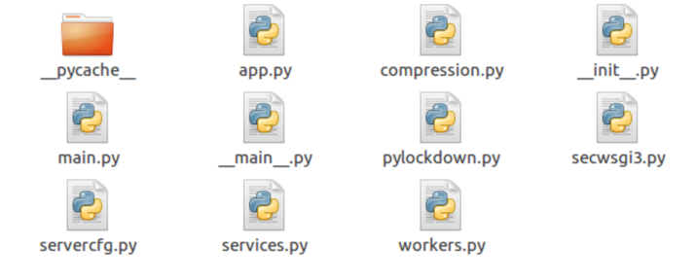
Task 6 – Getting Pyserver code
Method 1
Use python zipfile to extract extra
Write code/use program to decrypt
Method 2
Run server
Check /tmp folder for extracted code

Slide 44
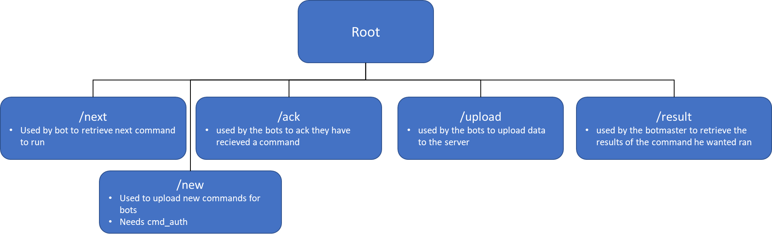
Task 6 – Web Server URLs

Slide 45
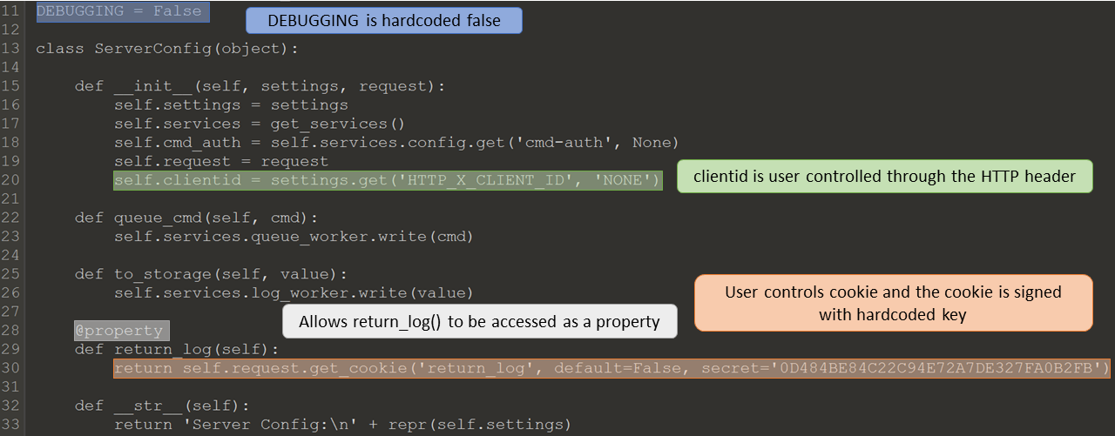
Task 6 – ServerCfg code
OWASP A1 Injection
HTTP_X_CLIENT_ID
OWASP A8 Insecure Deserialization
Cookie return_log

Slide 46
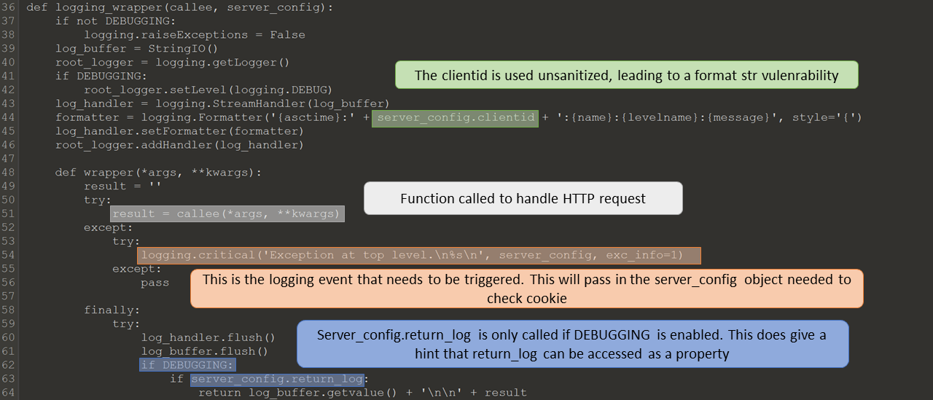
Task 6 – ServerCfg code
Utilizing the format string
Need to cause critical error
Need access to server_config object

Slide 47
Task 6 – Format String
The function return_log() needs to be called
String format can only access properties
What is @property

Slide 48
Task 6 – Python Pickle
Pickle
Can be used to serialize/deserialize objects
Bottle will automatically unpickle signed cookies
Pickle can be used to execute arbitrary python code

Slide 49
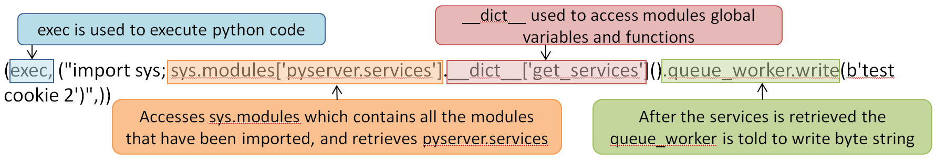
Task 6 – Python Pickle
Example of python code
Define __reduce__() for object
Set return to code
Pickle object

Slide 50
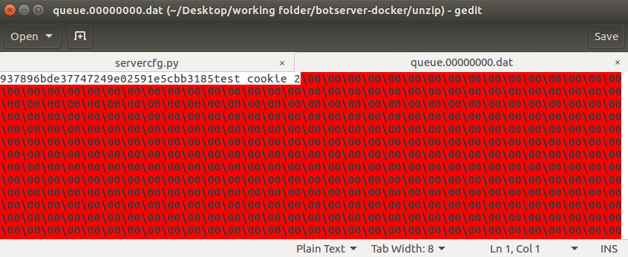
Task 6 – Testing Pickle
Set up test environment
Tested exploit

Slide 51
Task 6 – Causing Critical Error
Bottle Docs
Most errors are caught by bottle
Errors not caught
UnicodeError
Can be caused easily, but not useful
KeyboardInterrupt
Not useful
SystemExit
Not useful
MemoryError
Error we want to cause

Slide 52
Task 6 – Memory Error
/upload/<uid>
Accepted types plain text, gzip, and deflate
20MB limit on upload
Deflate will be decompressed
1GB chunks
Recompressed as gzip
/result/<uid>
Can pull down as plain text and gzip
No protection on decompression
Will cause memory error is file is too big

Slide 53
Task 6 – Memory Error
Process
Create gzip bomb through Python
Compressed 1.8GB of “0”s
Upload as gzip
Content-Encoding: gzip
Request result as plain text
Accept-Encoding: identity

Slide 54
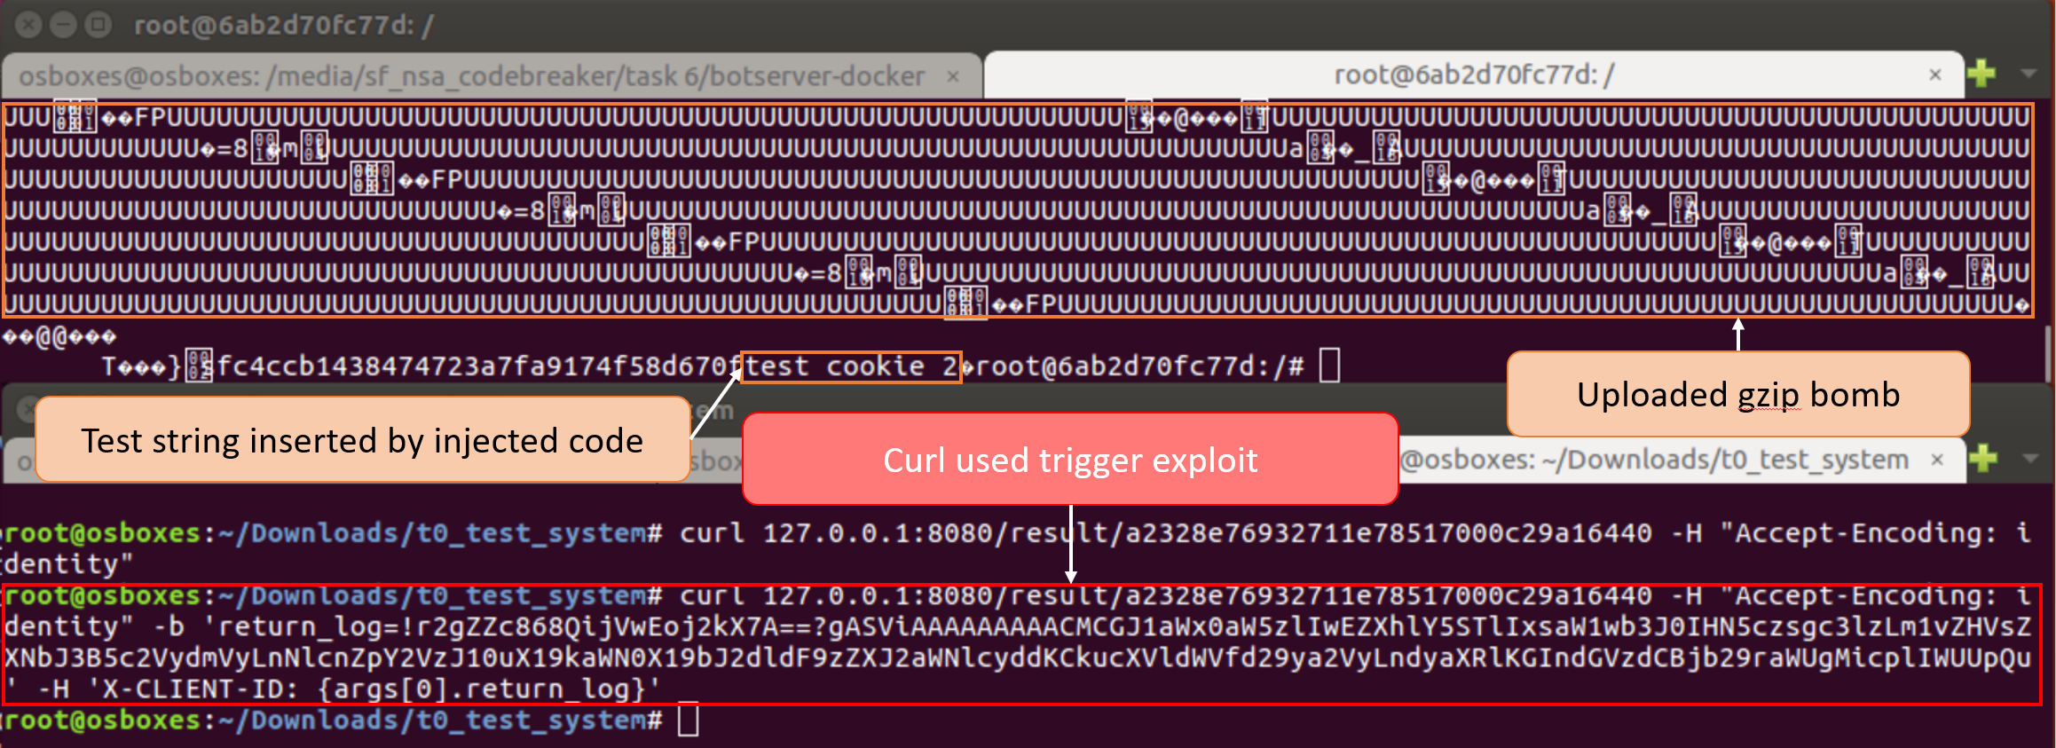
Task 6 – Test Exploit
Testing exploit using curl

Slide 55
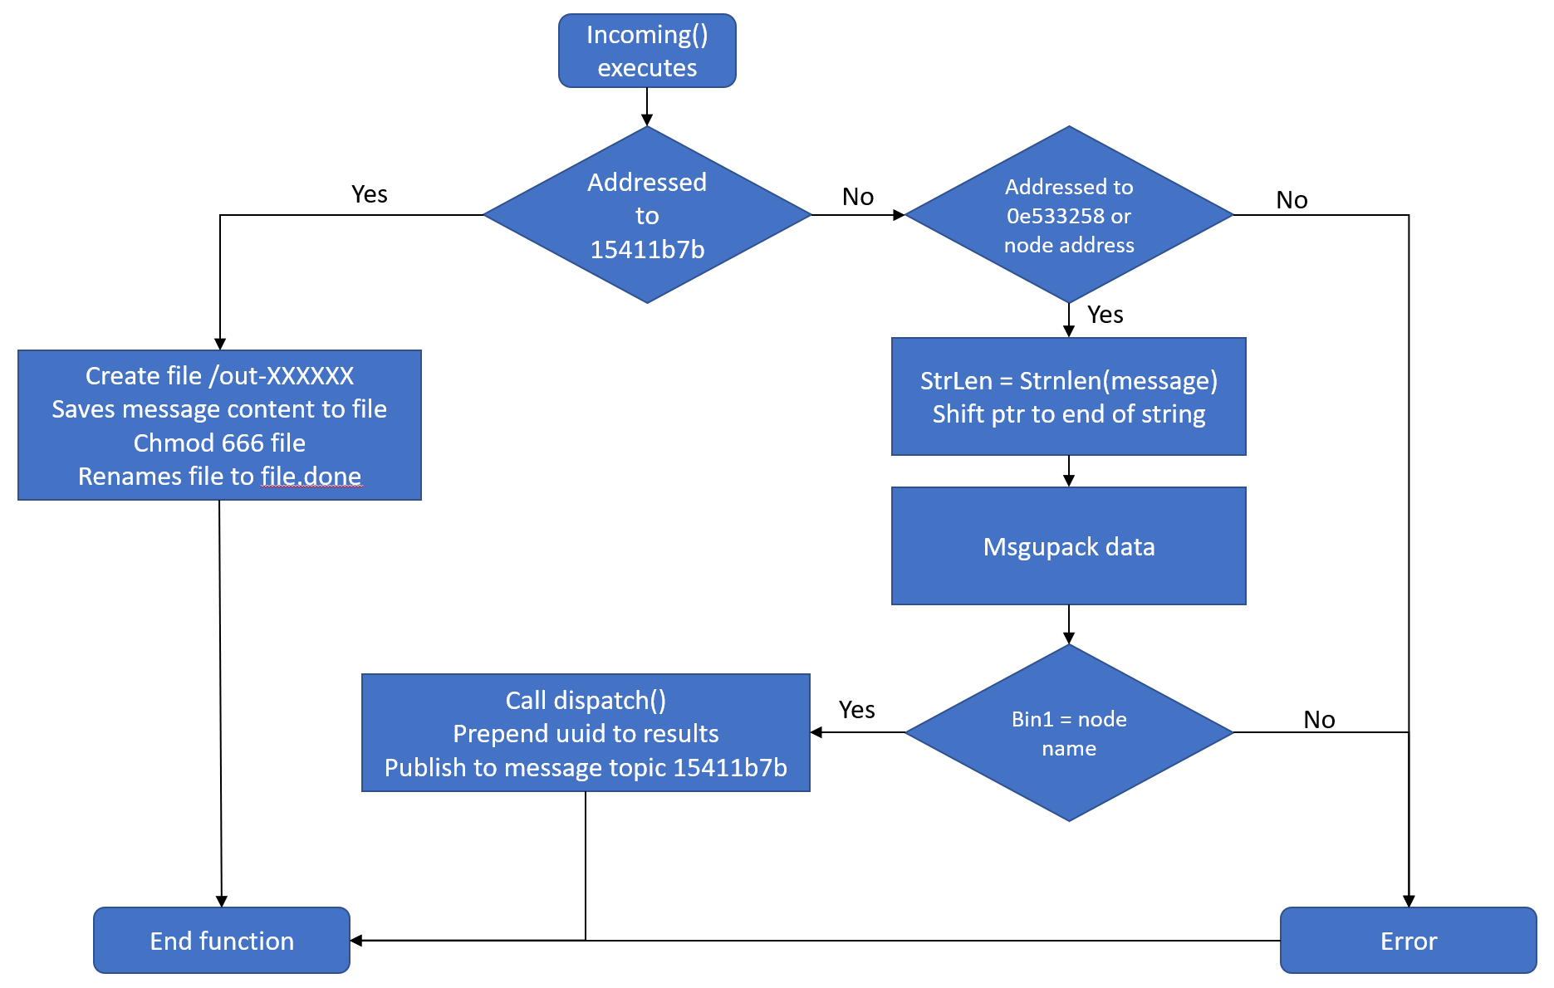
Task 6 – Determine Bot Commands
Flow of bot’s incoming()

Slide 56
Task 6 – Determine Bot Commands
Bot listens for 3 topics
nodes-15411b7b, Bridge
nodes-0e53325b, Broadcast
nodes-XXXXXXXX, Unique identifier
Bot commands are msgpack
Fixarray (0x90-0x9f):
Send a fixed number of objects
1-15 elements
Int32 (0xd2):
Send 32 bit integer
Bin32 (0xc6):
Send binary data
1-(2^32) bytes

Slide 57
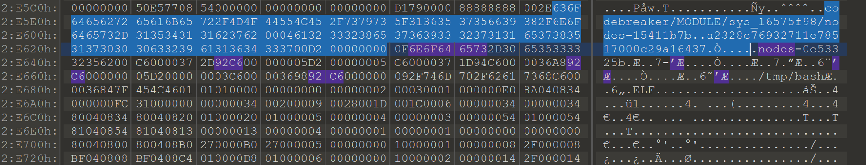
Task 6 – Determine Bot Commands
Example of bot commands
Found in agent’s heap
Agent just handled messages

Slide 58
Task 6 – Repair First Command
MQTT Topic
Same, but to broadcast node
Can use same uuid or change
After null byte
Fixarray 0x9X
Bin 0xC6<int>

Slide 59
Task 6 – Repair First Command
We now have the format for the enable bridge command
Bridge is set to connect to 10.134.97.12
Need to change this

Slide 60
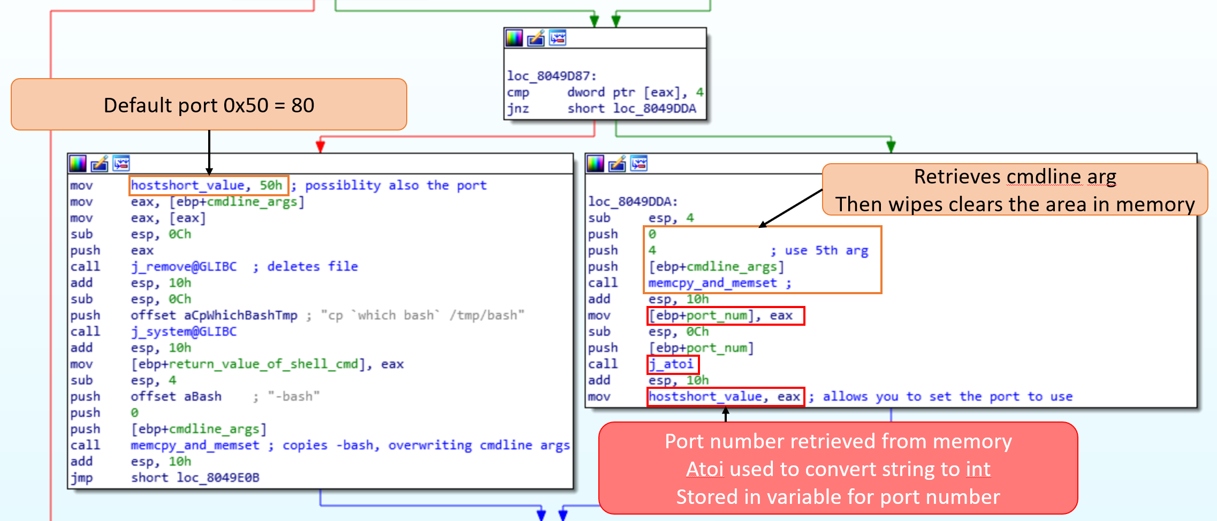
Task 6 – Bridge Command Arguments

Slide 61
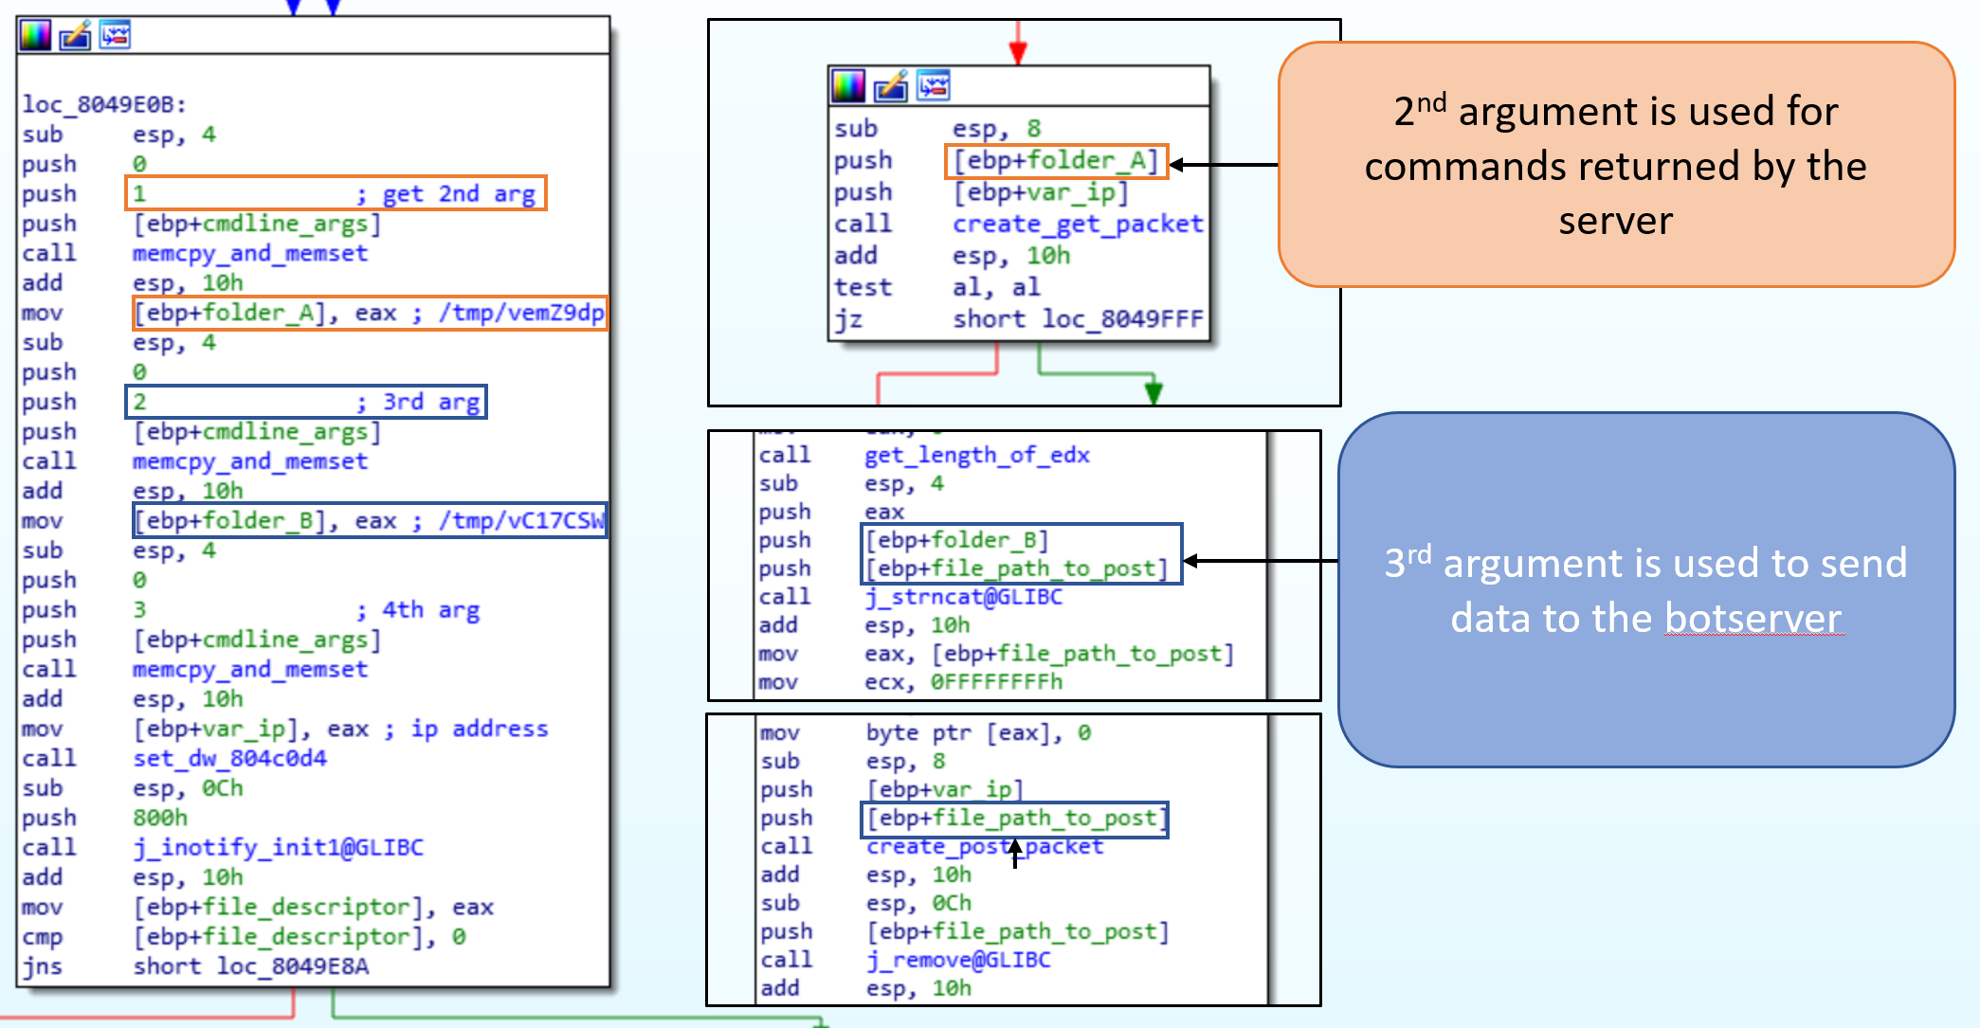
Task 6 – Bridge Command Arguments

Slide 62
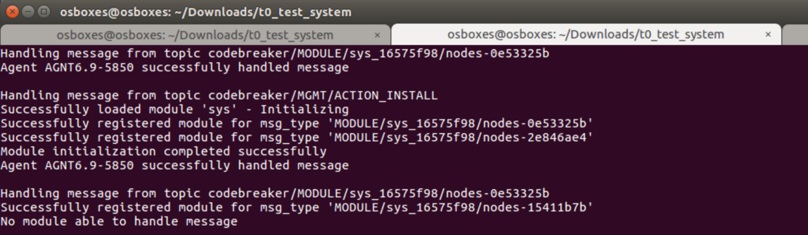
Task 6 – Sending Enable Bridge Command
Change
‘10.134.97.12 &’ to ‘127.0.0.1 8080&’

Slide 63
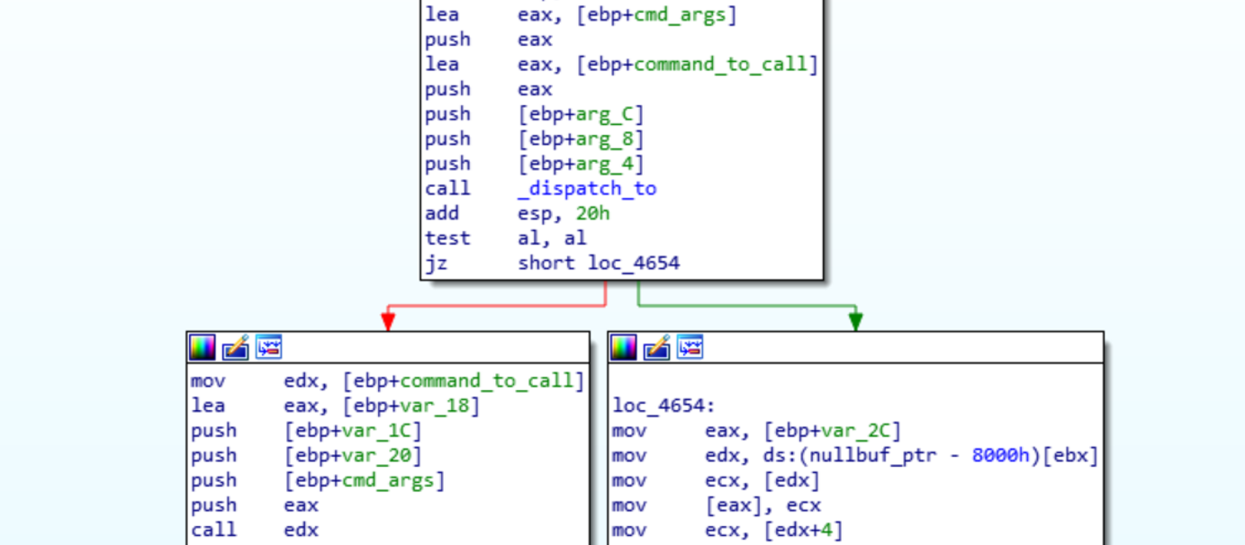
Task 6 – What Commands Bot Has
Bot dispatch function

Slide 64
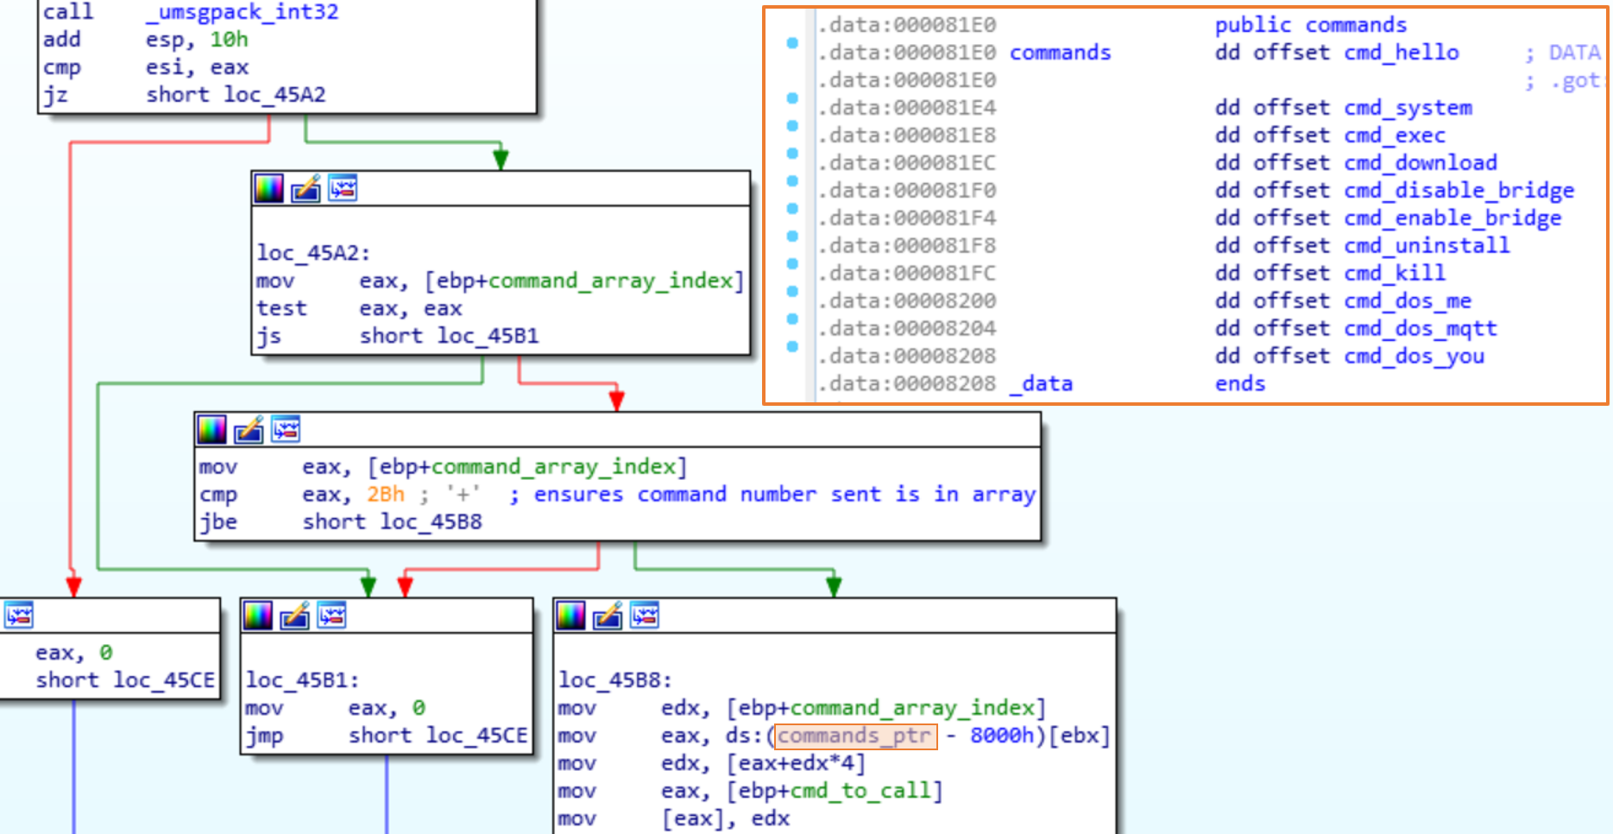
Task 6 – What Commands Bot Has
Bot dispatch_to function

Slide 65
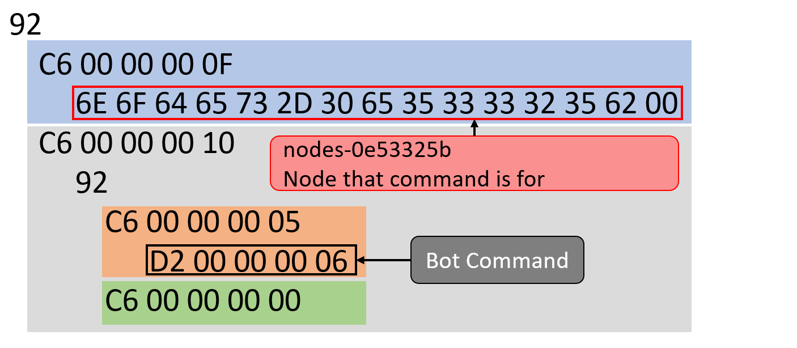
Task 6 – Uninstall Command
Call cmd_uninstall
6th Command

Slide 66
Task 6 – Uninstall Command
Send message
<topic><uid><msgpack data>

Slide 67
Task 6 – Delivering Exploit
Have to send on bridge topic
Format <mqtt topic><uid><data>
Only have /upload/<uid>
No place to headers
X-CLIENT-ID
Cookie
Analyze bridge code
Look for exploit

Slide 68
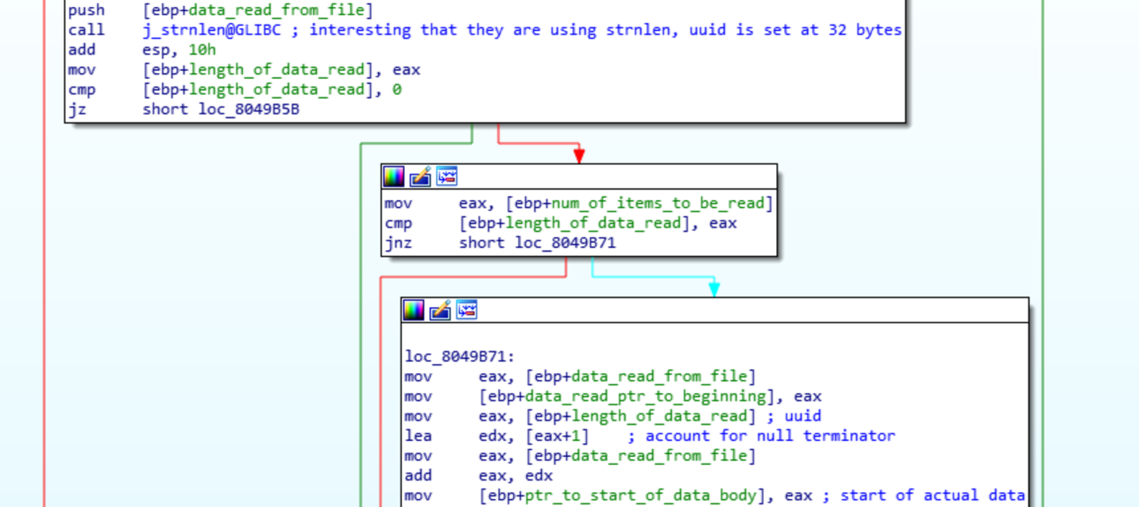
Task 6 – Delivering Exploit
Bridge’s POST function
Uses strnlen() to get uid
The uid is always 32 chars though

Slide 69
Task 6 – HTTP Pipelining
We can inject arbitrary length text
HTTP headers are text based
Can do HTTP pipelining
Send multiple HTTP requests through single TCP connection
Used to speed up protocol
Connection: keep-alive

Slide 70
Task 6 – HTTP Pipelining
String stops on NULL byte
Gzip will contain NULL bytes
Second method
Finish first HTTP header
Tell protocol headers injected by bot are data
Add additional HTTP requests after first request

Slide 71
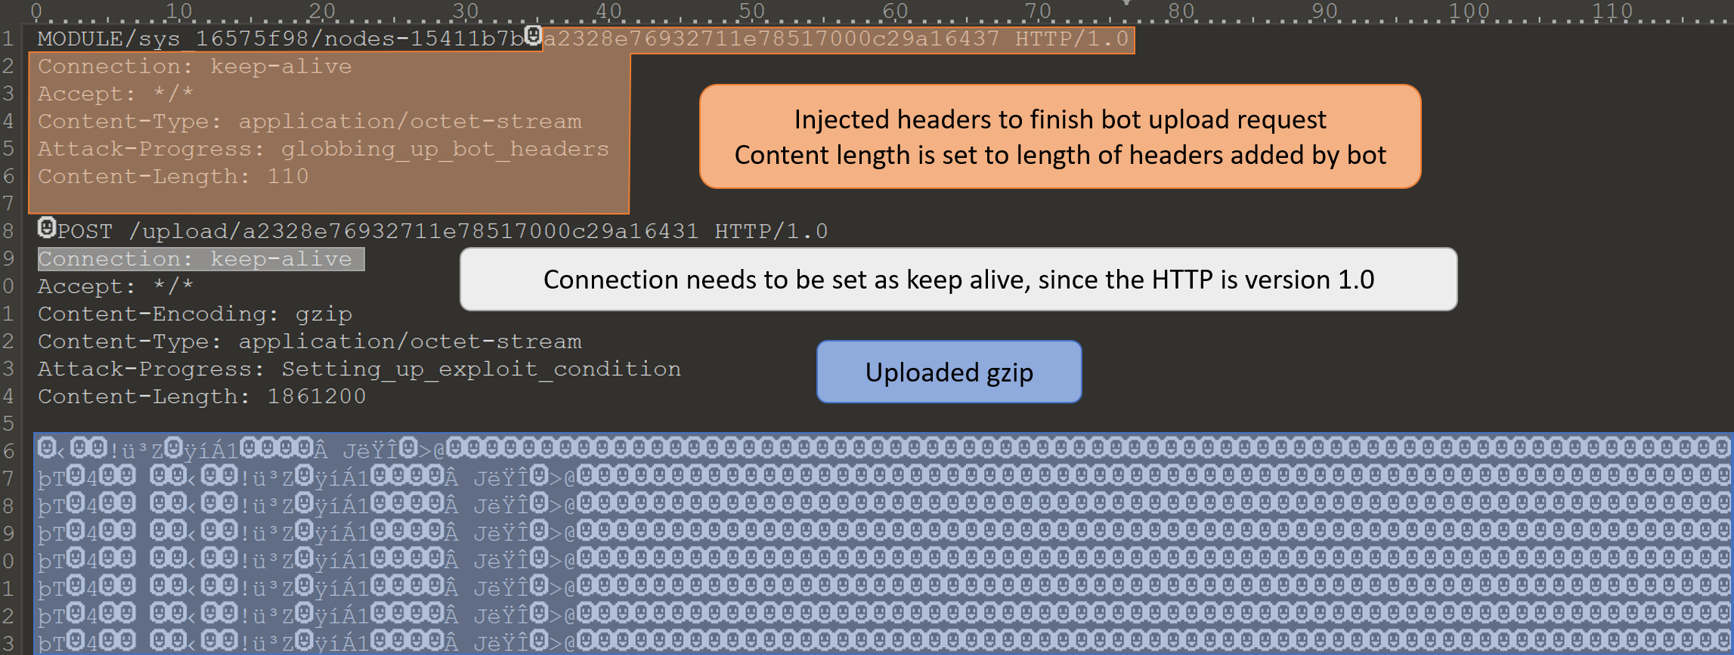
Task 6 – HTTP Pipelining Format

Slide 72
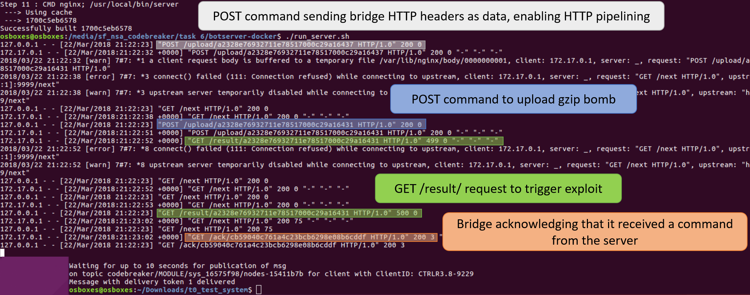
Task 6 – Sending Exploit

Slide 73
Task 6 – Sending Exploit
Message Sent
Command Sent
Message Stored
Queue
bot
Uninstall
command
C2 server
Bot headers
Uninstall
command
Gzip
bomb
/next
Command Stored
bridge
Result
request
Gzip
bomb
Bot headers
Result
Memory
Error
Log critical error

Slide 74
Questions?

